Slide 1
释放 ARM64 Windows 设备的无限潜能
毛利 (Kenji Mouri)
微软最有价值专家 (MVP)

Slide 2
Microsoft Build Session 参考
Learn how to build the best Arm apps for Windows
https://build.microsoft.com/en-US/sessions/4c00afb9-e345-489c-bf7f-bfd6ecfde455
Optimize your apps for Arm, Q&A
https://build.microsoft.com/en-US/sessions/4a5f9357-7e15-4a5f-ac33-3a5bae88684c

Slide 3

Last year
Last year
Desktop development with C++
.NET desktop development - .NET and .NET Framework
ASP.NET and Web development
Universal Windows Platform apps

Slide 4

Visual Studio Arm64
Visual Studio Arm64
Visual Studio Extension development
Game development with C++
Node.js development
Linux development for C++
MAUI

Slide 5

C++ Tools
Full Arm hosted C++ development environment
Industrial strength peak optimizations like x64
Auto-vectorization
Profile feedback optimization
Arm64 machine specific code generation
AArch64 v8.2+ intrinsic support
New processor features to target new atomics
New tile-based register allocator to exploit larger machine register file

Slide 6

Java on Arm
Microsoft OpenJDK 17 LTS
Arm specific improvements
Microsoft OpenJDK build toolchain takes advantage of Arm ISA 8.2+ features
Optimized Runtime to leveraging Large System Extension (LSE) switch
Java workloads
MD5 re-implemented to use Intrinsics
Escape Analysis update reduces allocation pressure on the heap
Numerous fixes to the GC and JIT

Slide 7
Middleware and tools available
aka.ms/ArmOSS
Project
LLVM
40% of OSS build with Clang | Delivered with v12.0. Arm64EC experimental work.
Used by over 1m developers | Version 6.2 onwards
Over 30% of github projects use this | Official releases are available from CMake 3.24
Popular test framework | Official releases are available from Bazel 5.1
Used by >600k developer teams | Available LTS in OpenSSL 3.0 and later.
>880k downloads per day | Binaries available since Oct 2022
Common dependency for algorithm functions in popular apps | Build from source versions v0.3.21
Used by >8m developers | Arm installer is available from python 3.11
Popular Windows installer tool | dotnet tool install --global wix --version 4.0.0
Commonly used with over 11m downloads per year | V20.0.0 delivered in April
Qt
CMake
Bazel
OpenSSL
VLC
OpenBLAS
Python
WiX
Node

Slide 8
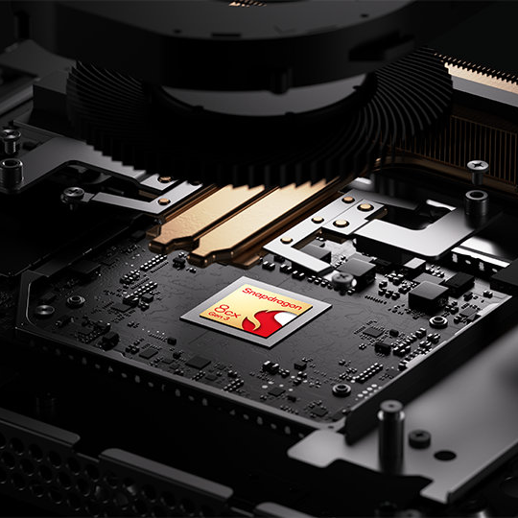
Windows Dev Kit 2023
32GB LPDDR4x RAM
512GB fast NVMe storage
Snapdragon® 8cx Gen 3
4 Cortex-X1 + 4 Cortex-A78
Hexagon dsp (NPU)
Ports:
3x USB-A
2x USB-C
Mini-Display (HBR2 support)
Ethernet (RJ45)
Case made with 20% recycled ocean plastic

Slide 9

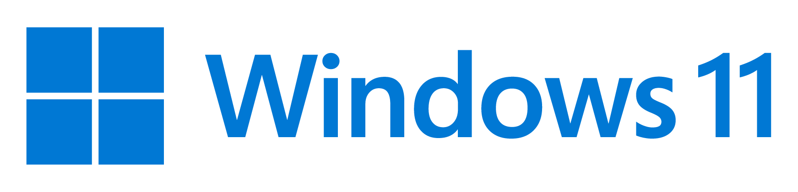

Unity 23.1 (Beta today, GA this summer)
Arm native with lower CPU usage & faster loading
Unity 23.2 (later this year)
Render Pass + Render Graph for lower GPU usage, better graphics
URP 3D Sample Scene, The Garden

Slide 10
为什么选择这个话题

Slide 11
ARM64 Windows 设备的意义
不插电完整性能释放
更好的续航表现
无风扇设计和高性能兼得
实现更低的 D 面温度

Slide 12
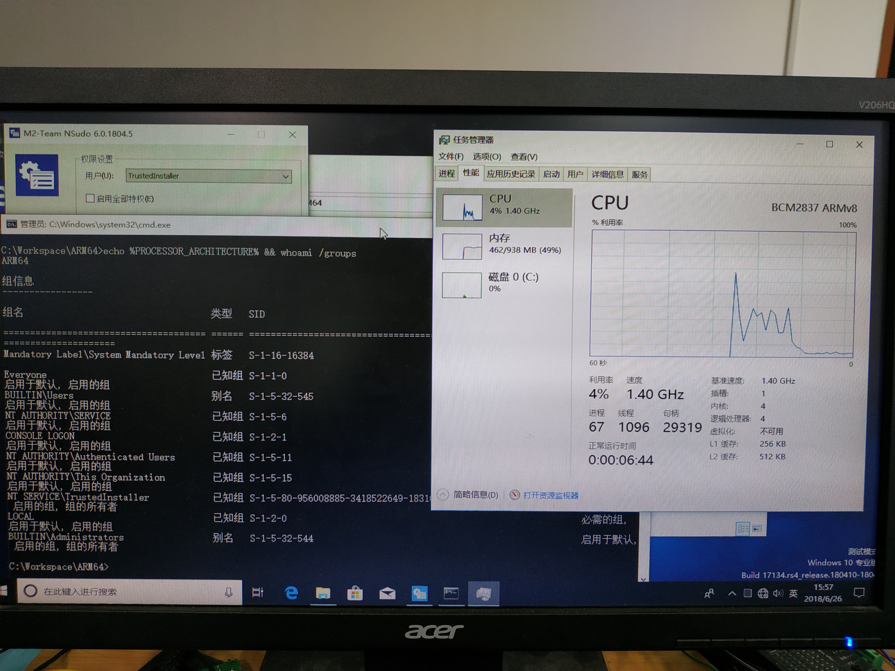
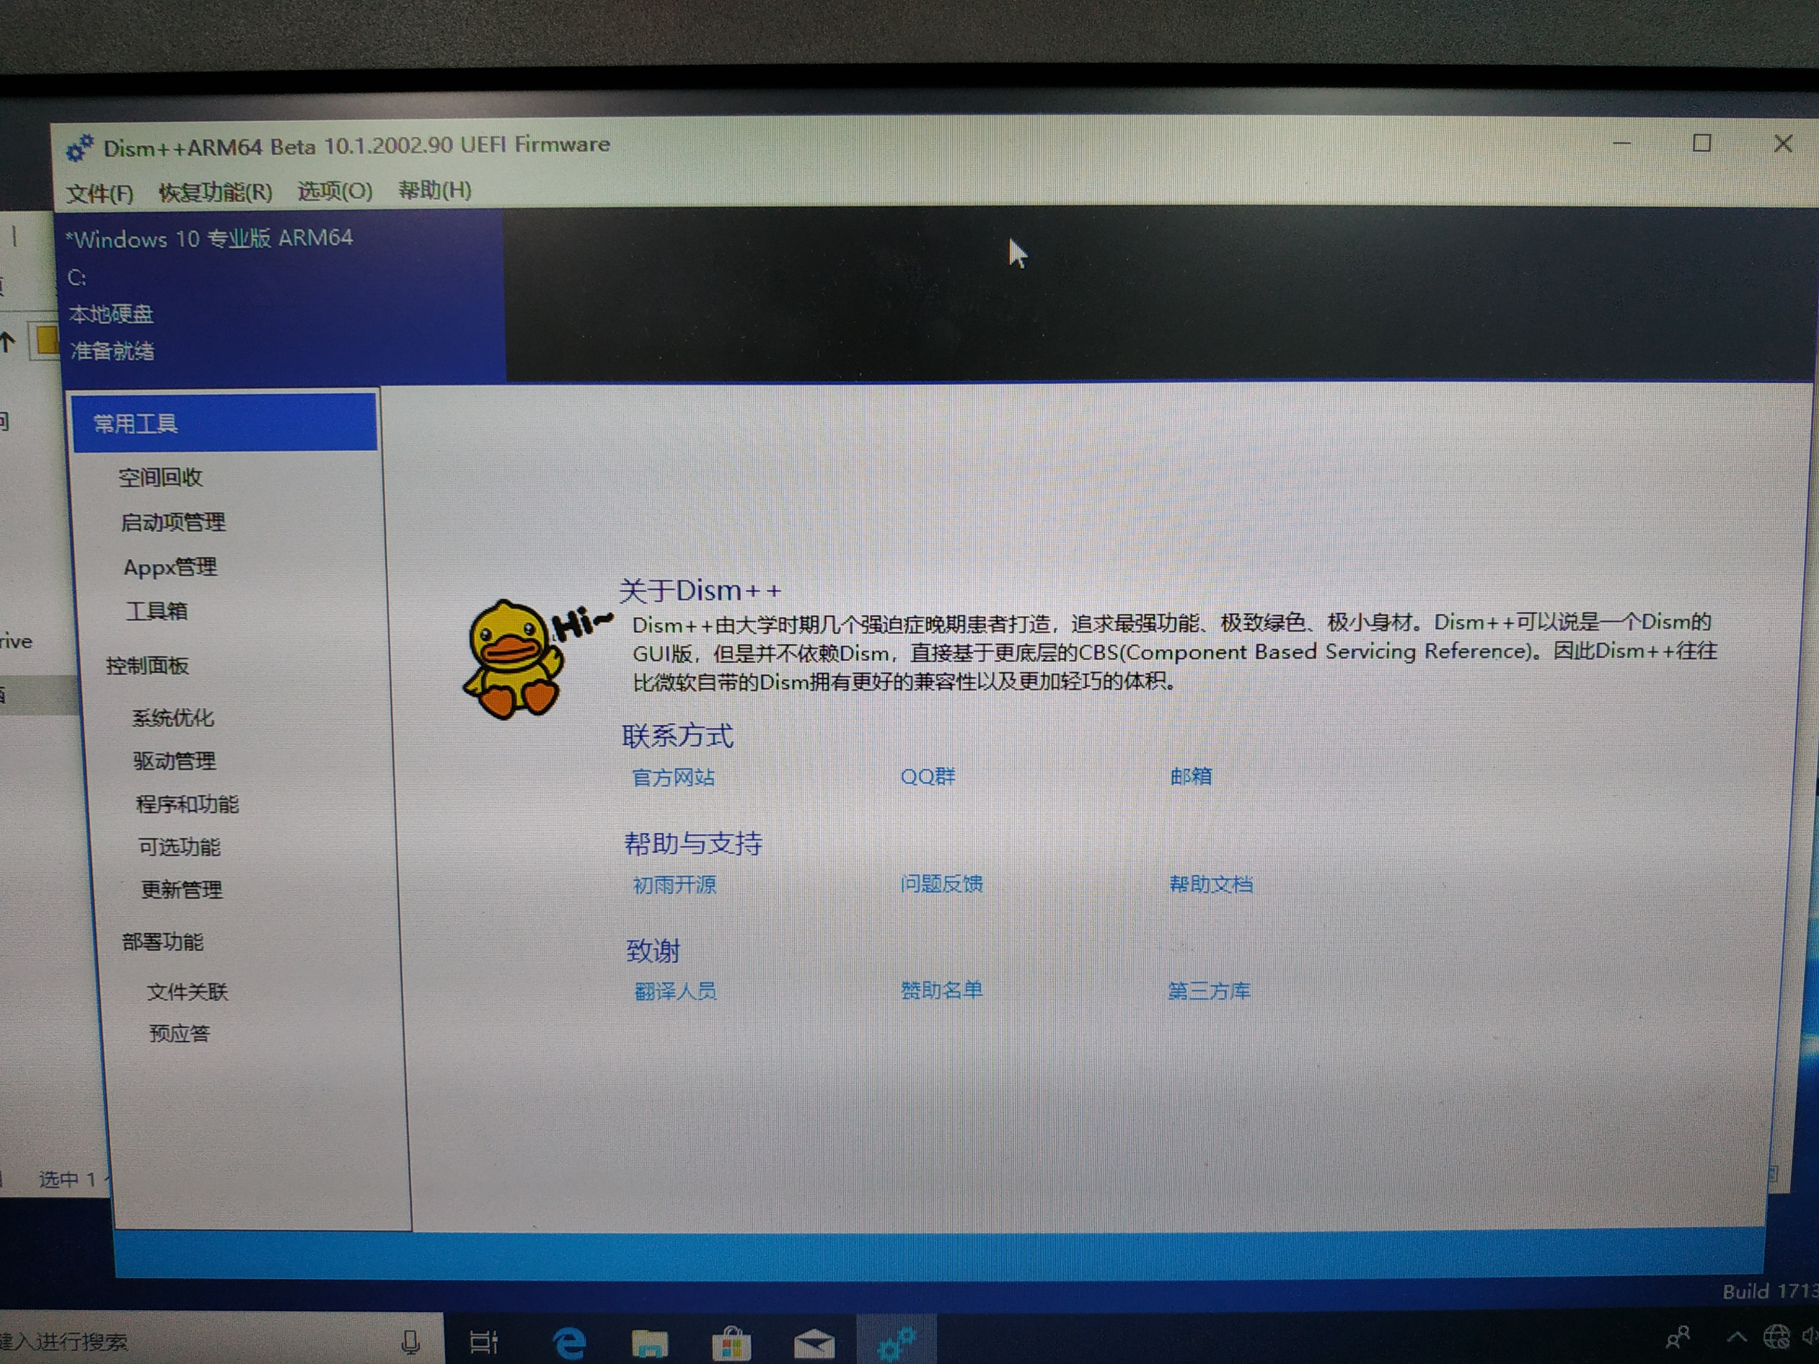
2017 年开始参与 ARM64 适配

Slide 13
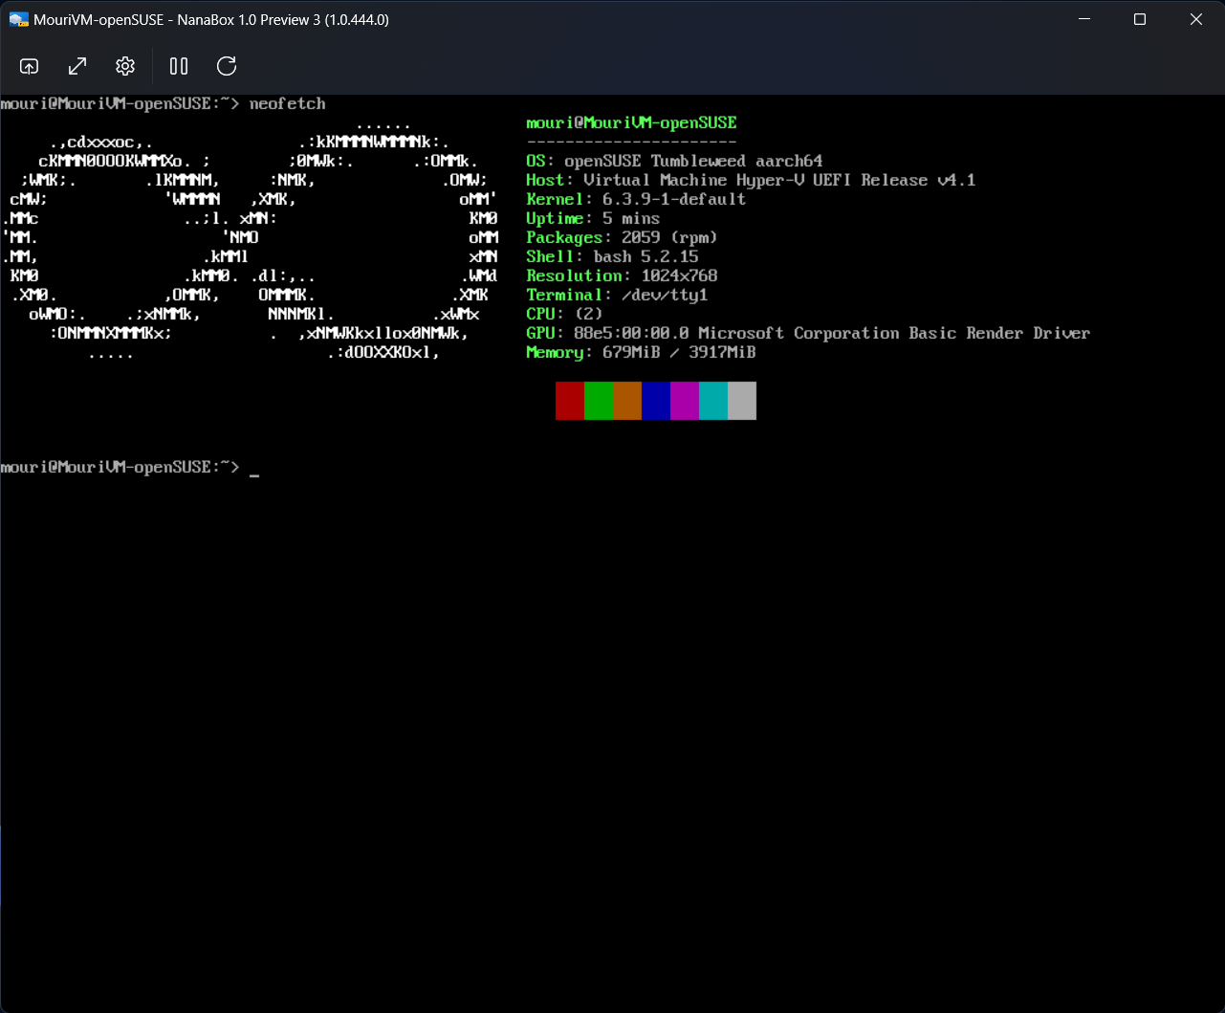
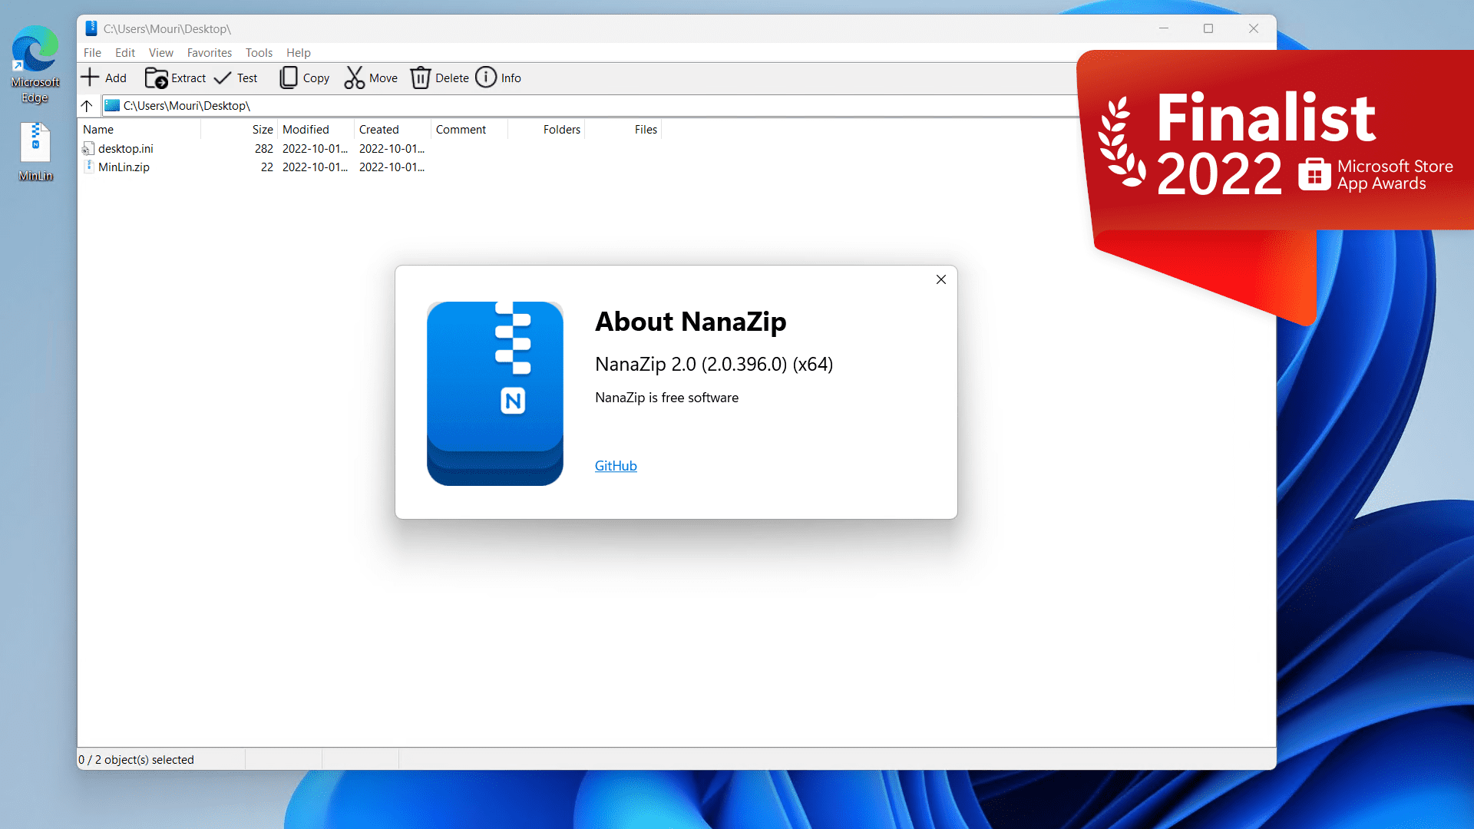
负责维护的项目皆提供 ARM64 支持
NanaZip – 文件归档工具
https://github.com/M2Team/NanaZip
NanaBox – 虚拟化客户端
https://github.com/M2Team/NanaBox

Slide 14
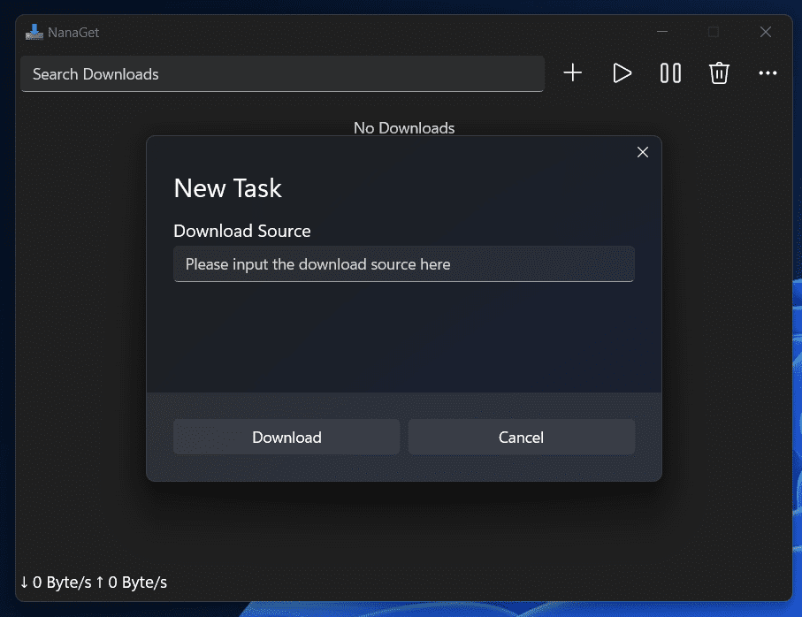
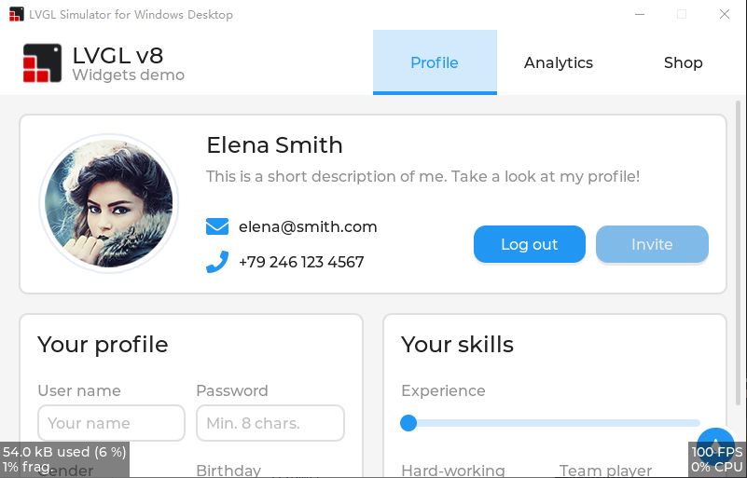
负责维护的项目皆提供 ARM64 支持
NanaGet – 文件下载工具
https://github.com/M2Team/NanaGet
LVGL Windows 平台模拟器
https://github.com/lvgl/lv_port_pc_visual_studio

Slide 15
演示：Stable Diffusion GUI
推理框架采用 https://github.com/Tencent/ncnn
我对其贡献了 ARM64 Windows 目标支持
作者是我的朋友，想切实的支持一下
是 https://github.com/EdVince/Stable-Diffusion-NCNN 的 GUI
本示例源代码可在该仓库的 feature/windows-gui 分支或者主分支找到
想对朋友提供切实的支持，遂不单独创建仓库
仅使用 CPU 后端
高通设备 GPU 驱动仅提供 Direct3D 12 支持，无 ncnn 所需的 Vulkan 支持
Mesa3D 的 dozen 转换层包含我贡献的 bug 修复的下个稳定版本尚未出现
方便展示和解释 ARM64 原生和 x64 转译的性能差异的原因

Slide 16
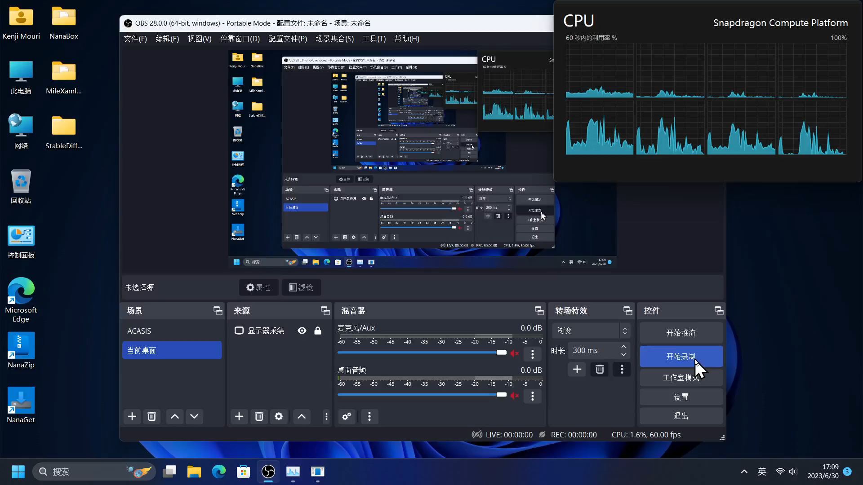
ARM64 原生版本演示

Slide 17
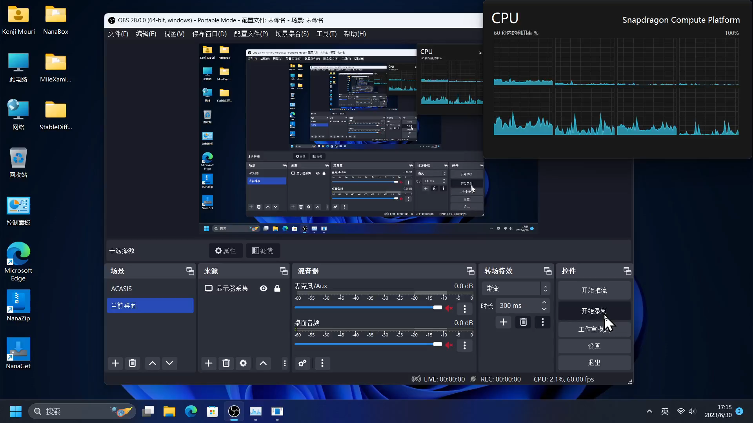
x64 转译版本演示

Slide 18
为什么转译版本好于原生版本
因为 MSVC 的 ARM64 编译器不支持内联汇编，无法使用 ncnn 的 ARM64 后端提供的大量内联汇编优化
Clang CL 的 ARM64 编译器编译会出现因为 ncnn 的 arm64 目标的优化函数写的太长直接导致编译器崩溃的情况
conv3x3s1_winograd_gemm_transB_packed_tile
convolution_gemm_transB_packed_tile_bf16s
convolution_gemm_transB_packed_tile
由于 i7-11800H 下跑仅启用 SSE2 的 ncnn 的 Stable Diffusion 实例的性能和刚刚演示的转译版本的速度相当，且 ARM64 Windows 的 x64 转译大概仅支持到 SSE 4.1 指令集，遂实际上转译性能相当不错，而且也说明了 ARM64 原生版本的优化上限极高

Slide 19


Slide 20

Microsoft Learn 的 Microsoft Build 主题

Slide 21
谢谢

